Slide 1

Dr. Sajid Iqbal
Department of Computer Science
Bahauddin Zakariya University, Multan

Slide 2

INTRODUCTION TO Machine Learning 3rd Edition
ETHEM ALPAYDIN
© The MIT Press, 2014
alpaydin@boun.edu.tr
http://www.cmpe.boun.edu.tr/~ethem/i2ml3e

Slide 3
Multivariate Methods
Chapter Five

Slide 4
Multivariate Classification

Slide 5
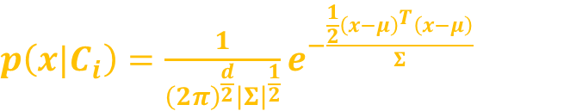

If $xεℜ^{d}$ and class conditional densities $p(x|C_{i})$ are taken as normal density $N_{d}(μ_{i},Σ_{i})$ then
While real data may not often be exactly multivariate normal, it is a useful approximation
One clear requirement is that the sample of a class should form a single group; if there are multiple groups, one should use a mixture model
$p\left(x|C_{i}\right)=\frac{1}{{\left(2π\right)}^{\frac{d}{2}}{\left|Σ\right|}^{\frac{1}{2}}}e^{−\frac{\frac{1}{2}{\left(x−μ\right)}^{T}\left(x−μ\right)}{Σ}}$

Slide 6

Example of Multi-variate classification
Let $X=\left\{age,income\right\}, y=\left\{type of car\right\},$
$μ_{i}={\left\{μ_{age}, μ_{income}\right\}}_{i}$: A Vector of mean age and income of customers who buy car type i
$Σ_{i}={\left[\begin{matrix}σ_{age}σ_{age} & σ_{age}σ_{income} \\ σ_{age}σ_{income} & σ_{income}σ_{income}\end{matrix}\right]}_{i},$
$σ_{i1}^{2}$= variance of age who buy car of type $i$
$σ_{i2}^{2}$= variance of income who buy car of type $i$
$σ_{i12}$= covariance of age and income of customers who buy car of type $i$
The discriminant function is given as
$g_{i}(x) = log⁡p(x|C_{i}) + log⁡P(C_{i})$ assuming that $p(x|C_{i}) ∼ N_{d}(μ_{i}, Σ_{i})$

Slide 7


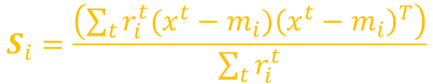

$g_{i}(x) = log⁡p(x|C_{i}) + log⁡P(C_{i})$ assuming that $p(x|C_{i}) ∼ N_{d}(μ_{i}, Σ_{i})$
Then we have $g_{i}\left(x\right)= −\frac{d}{2}\log{2π}−\frac{1}{2}\log\left|Σ_{i}\right|−\frac{1}{2}{\left(x − μ_{i}\right)}^{T}Σ_{i}^{−1}(x−μ_{i})+log⁡P(C_{i})$
Let the training set has $K ≥ 2$classes, $X = \{x^{t}, r^{t}\},$
where $r_{i}^{t}=1$ if $x^{t}∈C_{i}$and $0$ otherwise
Estimates for the $μ$ and $Σ$are found using maximum likelihood separately for each class
$$\hat{P}\left(C_{i}\right)=\frac{\sum_{t}{r_{i}^{t}}}{N}$$
$$m_{i}=\frac{\sum_{t}{r_{i}^{t}x^{t}}}{\sum_{t}{r_{i}^{t}}}$$
$$S_{i}=\frac{\left(\sum_{t}{r_{i}^{t}(x^{t}−m_{i}}){\left(x^{t}−m_{i}\right)}^{T}\right)}{\sum_{t}{r_{i}^{t}}}$$

Slide 8



By plugging the values into discriminant function
$$g_{i}(x) = −\frac{1}{2} log⁡|S_{i}|−\frac{1}{2}{\left(x−m_{i}\right)}^{T}S_{i}^{−1}(x−m_{i})+log⁡\hat{p}(C_{i})$$
$$g_{i}(x) = −\frac{1}{2} log⁡|S_{i}|−\frac{1}{2}(x^{T}S_{i}^{−1}x−2x^{T}S_{i}^{−1}m_{i}+m_{i}^{T}S_{i}^{−1}m_{i})+log⁡\hat{p}(C_{i})$$
It defines the quadratic function. Which can also be written as
$$g_{i}(x) = x^{T} W_{i}x+w_{i}^{T} x+ w_{i0}$$
where
$$W_{i}=−\frac{1}{2}S_{i}^{−1}$$
$$w_{i}=S_{i}^{−1}m_{i}$$
$$w_{i0}=−\frac{1}{2}m_{i}^{T}S_{i}^{−1}m_{i}−\frac{1}{2}log\left|S_{i}\right|+log\hat{p}(C_{i})$$

Slide 9

Dimensionality Reduction
The number of parameters to be estimated are $K·d$for the means and $K·d(d + 1)/2$for the covariance matrices
If d (features) are large and sample dataset size is small
$S_{i}$may be singular and inverses may not exists or $S_{i}$may be too small
In this case $S_{i}$will be unstable, small changes in $S_{i}$ will result in large change in $S_{i}^{−1}$
For stable estimate on small samples
Decrease the dimensionality of the data i.e. reduce d
Redesign the feature extractor and select subset of features or merge them to small amount

Slide 10

Another possibility is to pool the data and estimate a common covariance matrix for all classes:
In this case of equal covariance matrices
The equation reduces to
If the priors are equal
the optimal decision rule is to assign input to the class whose mean’s Mahalanobis distance to the input is the smallest
$$S=\sum_{i}{\hat{P}\left(C_{i}\right)S_{i}}$$
$$g_{i}(x) = −\frac{1}{2} log⁡|S_{i}|−\frac{1}{2}{\left(x−m_{i}\right)}^{T}S_{i}^{−1}(x−m_{i})+log⁡\hat{p}(C_{i})$$
$$g_{i}(x) = −\frac{1}{2}{\left(x−m_{i}\right)}^{T}S_{i}^{−1}(x−m_{i})+log⁡\hat{p}(C_{i})$$

Slide 11
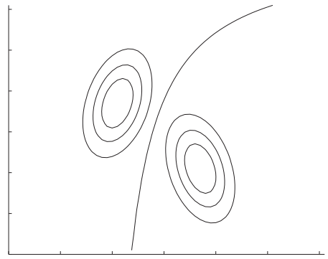
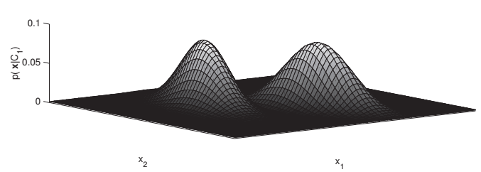
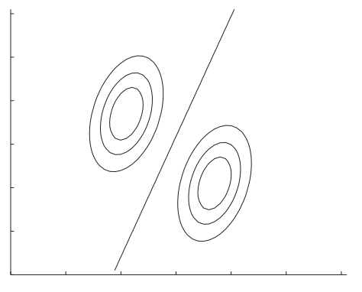
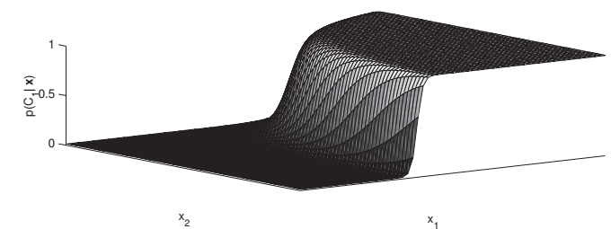
Discriminant
Class distributions
Likelihood densities
Covariances may be arbitrary but shared by
both classes
Posterior Probabilities

Slide 12
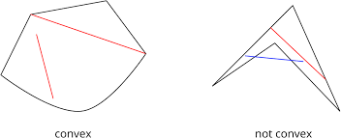

Linear Discriminant
Unequal priors shift the boundary toward the less likely class
In this case, the quadratic term $x^{T}S^{−1}x$ cancels since it is common in all discriminants
The decision boundaries are linear, leading to a linear discriminant
$g_{i}(x) = w_{i}^{T}x+w_{i0}$ where
$w_{i0}= −\frac{1}{2}m_{i}^{T}S_{i}^{−1}m_{i}+log⁡\hat{p}(C_{i})$
Decision regions of such a linear classifier are convex

Slide 13

Naïve Bayes Classifier
If we assume all off-diagonals of the covariance matrix to be 0, more simplification is possible
The problems becomes univariate
$g_{i}\left(x\right)=−\frac{1}{2}\sum_{j=1}^{d}{{\left(\frac{x_{j}^{t}−m_{ij}}{s_{j}}\right)}^{2}+\log{\hat{P}}(C_{i})}$
The term $\frac{x_{j}^{t}−mij}{s_{j}}$ has the effect of normalization and measures the distance in terms of standard deviation units.

Slide 14
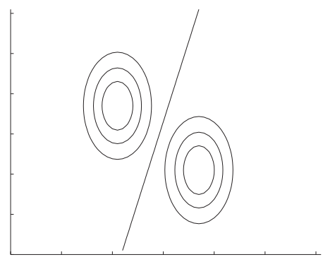

As the covariances are zero, classes are hyperellipsoidal are axis-aligned
The number of parameters is
$K·d$for the means
$d$ for the variances.
Thus the complexity of $S$ is reduced from $O(d^{2})$to $O(d)$
All classes have equal,
diagonal covariance matrices,
but Variances are not equal

Slide 15
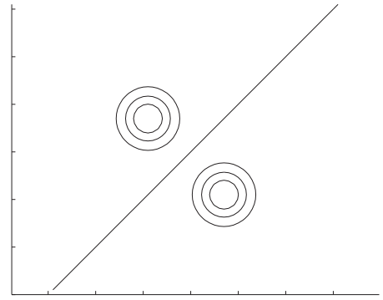

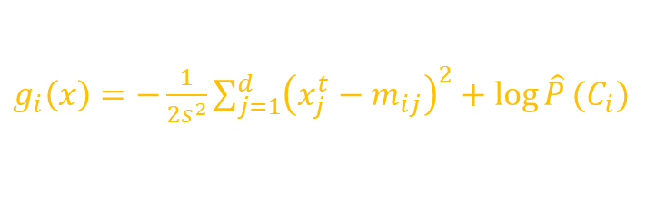

Euclidian Distance
Simplifying even further, if we assume all variances to be equal, the Mahalanobis distance reduces to Euclidean distance
The distribution is shaped spherically, centered around the mean vector $m_{i}$
Then $|S|=s^{2d}$and $S^{−1} = (1/s^{2})I$.
The number of parameters in this case is $K·d$for the means and $1$ for $s2$
All classes have equal,
diagonal covariance
matrices of equal variances
on both dimensions
$$g_{i}\left(x\right)=−\frac{{\left\|x−m_{i}\right\|}^{2}}{2s^{2}}+\log{\hat{P}}(C_{i})$$
$g_{i}\left(x\right)=−\frac{1}{2s^{2}}\sum_{j=1}^{d}{{\left(x_{j}^{t}−m_{ij}\right)}^{2}+\log{\hat{P}}(C_{i})}$

Slide 16



Nearest Mean Classifier
$$g_{i}\left(x\right)=−\frac{{\left\|x−m_{i}\right\|}^{2}}{2s^{2}}+\log{\hat{P}}(C_{i})$$
If the priors are equal then eq. reduces to
Now $g_{i}\left(x\right)$ assigns the class to input $x$ which has least difference
If mean is considered as reference point (ideal prototype)
It becomes the templated for that class and the process is known as template matching
This can be expanded as
$$g_{i}\left(x\right)=−{\left\|x−m_{i}\right\|}^{2}$$
$$g_{i}\left(x\right)= −{\left\|x−m_{i}\right\|}^{2}$$
$$=−{\left(x−m_{i}\right)}^{T}\left(x−m_{i}\right)$$
$$= −(x^{T}x−2m_{i}^{T}x + m_{i}^{T}m_{i})$$

Slide 17

Nearest Means Classifier
$$g_{i}(x)= −(x^{T}x−2m_{i}^{T}x + m_{i}^{T}m_{i})$$
The first term, $x^{T}x$, is shared in all $g_{i}(x)$ and can be dropped
$g_{i}(x) = w_{i}^{T}x + w_{i0}$where $w_{i}=m_{i}$and $w_{i0} = −\left(\frac{1}{2}\right){\left\|m_{i}\right\|}^{2}$
If all $m_{i}$ have similar norms, then this term can also be ignored
$g_{i}(x) = w_{i}^{T}x$
When the norms of $mi$are comparable, dot product can also be used as the similarity measure instead of the (negative) Euclidean distance
We can think of finding the best discriminant function as the task of finding the best distance function

Slide 18


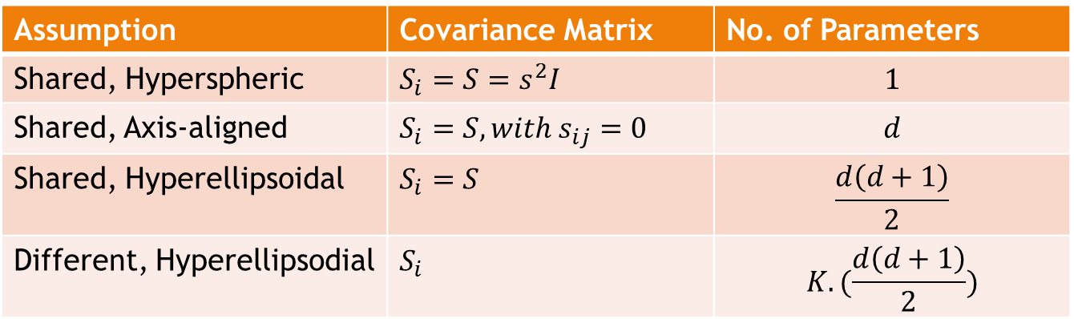
Summary
Instead of learning the discriminant functions, $g_{i}\left(x\right)$
Learn the suitable distance function $D(x_{1}, x_{2}),$such that for any $x1, x2, x3,$ where $x1$ and $x2$ belong to the same class, and $x1$ and $x3$ belong to two different classes, we would like to have
$$D(x_{1}, x_{2})<D(x_{1}, x_{3})$$
Reducing variance through simplifying assumptions
Assumption | Covariance Matrix | No. of Parameters
Shared, Hyperspheric | $$S_{i}=S=s^{2}I$$ | $$1$$
Shared, Axis-aligned | $$S_{i}=S, with s_{ij}=0$$ | $$d$$
Shared, Hyperellipsoidal | $$S_{i}=S$$ | $$\frac{d\left(d+1\right)}{2}$$
Different, Hyperellipsodial | $$S_{i}$$ | $$K.(\frac{d\left(d+1\right)}{2})$$

Slide 19
5.6 Tuning Complexity

Slide 20
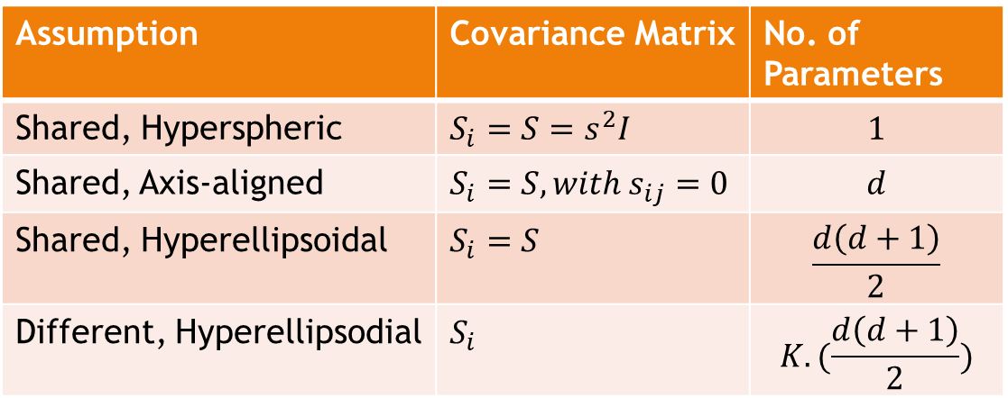
Reducing the number of parameters
The table shows how the number of parameters of the covariance matrix may be reduced
trading off the comfort of a simple model with generality
By making simplifying assumptions about the covariance matrices and decrease the number of parameters to be estimated, bias is introduced
if no such assumption is made and the matrices are arbitrary, the quadratic discriminant may have large variance on small datasets
A bias/Variance dilemma
The ideal case depends on the complexity of the problem and the amount of data
For a small dataset, even if the covariance matrices are different, it may be better to assume a shared covariance matrix
a single covariance matrix has fewer parameters
it can be estimated using more data, i.e. instances of all classes
This corresponds to using linear discriminants

Slide 21
Input Normalization
For Euclidean distance to measure similarity, it is assumed that all variables have the same variance and they are independent
In many cases, all variables do not have same variance
For example, age and yearly income have neither same variable nor are independent
In such a case, to use Euclidian Distance formula, the inputs may be separately z-normalized in a preprocessing stage (to have zero mean and unit variance)
On the other hand, even if the variables are dependent, it may be better to assume that they are independent and to use the naive Bayes’ classifier

Slide 22

Regularized Discriminant Analysis (RDA)
Regularization: Approaches that reduce high variance to lower variance at the risk of increasing bias
A method that combines all these as special cases is called (RDA)
For Gaussian parametric classification covariance matrices can be written as
$S_{i}=ασ^{2}I+βS+\left(1−α−β\right)S_{i}$
If $α=β=0$: The classifier is quadratic
If $α=0, β=$1: The classifier is linear and the covariance matrices are shared
If $α=1, β=0$: The classifier is nearest mean classifier and the covariance matrices are diagonal with $σ^{2}$ on the diagonals
In between these extremes, we get a whole variety of classifiers where $α, β$are optimized by cross-validation.
When the dataset is small, Bayesian approach by defining priors on $μ_{i} and S_{i}$or that uses cross-validation to choose the best of the four cases given in table.

Slide 23
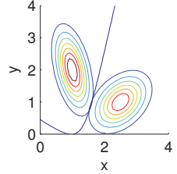
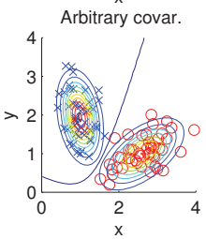
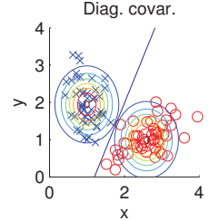
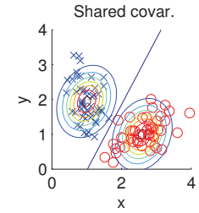
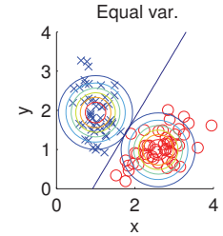
Population likelihoods and posteriors
Different cases of the covariance matrices fitted to the same data lead to different boundaries.

Slide 24
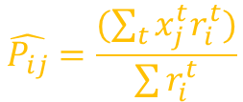

Discrete Features
In some applications discrete features are required which can not be normalized
Let such data belong to Bernoulli distribution then
$p_{ij} ≡ p(x_{j}=1|C_{i})$ and for n-independent trials
$p\left(x | C_{i}\right)=\prod_{j=1}^{d}{p_{ij}^{x_{j}}}{\left(1−p_{ij}\right)}^{1−x_{j}}$
The discriminant function is given by
$g_{i}\left(x\right)=\log{p\left(x | C_{i}\right)}+\log{P\left(C_{i}\right)}$
$\sum_{j}{\left[x_{j}log{(p}_{ij}\right)+\left(1−x_{j}\right)log⁡(1−p_{ij})]+log⁡p(C_{i})}$ which is linear
Estimator for $p_{ij}$ is
$$\hat{P_{ij}}=\frac{(\sum_{t}{x_{j}^{t}r_{i}^{t}})}{\sum{r_{i}^{t}}}$$

Slide 25
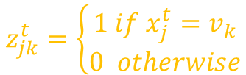


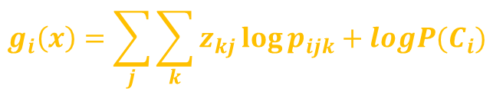
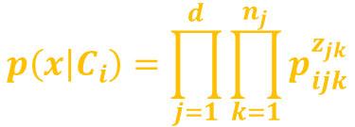
Discrete Features
In general case, let suppose we have k-classes $x_{j} ε \{v_{1},v_{2},…,v_{n_{j}}\}$
Define new 0/1 dummy variables as
Let $p_{ijk}$ denote the probability that $x_{j}$ belonging to $C_{i}$ takes value $v_{k}$
$p_{ijk} ≡ p(z_{jk}=1|C_{i})=p(x_{j}=v_{k}|C_{i})$
If attributes are independent then
The discriminant function is
MLE estimator for $p_{ijk}$ is
$$z_{jk}^{t}=\left\{\begin{aligned}1 if x_{j}^{t}=v_{k} \\ 0 otherwise\end{aligned}\right.$$
$$p\left(x | C_{i}\right)=\prod_{j=1}^{d}{\prod_{k=1}^{n_{j}}{p_{ijk}^{z_{jk}}}}$$
$$g_{i}\left(x\right)=\sum_{j}{\sum_{k}{z_{kj}\log{p_{ijk}}}+logP(C_{i})}$$
$$\hat{P_{ijk}}=\frac{\sum_{t}{z_{jk}^{t}r_{i}^{t}}}{\sum_{t}{r_{i}^{t}}}$$

Slide 26
Multivariate Regression

Slide 27

Multivariate Regression
Multivariate linear model is given as
$r^{t}=g\left(x^{t} | w_{0}, w_{1}, . . . , w_{d}\right)+ε=w_{0}+w_{1}x_{1}^{t}+w_{2}x_{2}^{t}+ · · · + w_{d}x_{d}^{t}+ε$
$ε$is assumed to be normal with mean 0 and constant variance
Maximizing the likelihood is equivalent to minimizing the sum of squared errors
$E\left(w_{0}, w_{1}, . . . , w_{d} | X\right)=\frac{1}{2}\sum_{t}{{\left(r^{t}−w_{0}−w_{1}x_{1}^{t}+w_{2}x_{2}^{t}−…−w_{d}x_{d}^{t}\right)}^{2}}$
Taking the derivative with respect to the parameters, $w_{j}, where j = 0, . . . , d,$we get these normal equations

Slide 28

$$\sum_{t}{r^{t}}=Nw_{0}+w_{1}\sum_{t}{x_{1}^{t}}+w_{2}\sum_{t}{x_{2}^{t}}+…+w_{d}\sum_{t}{x_{d}^{t}}$$
$$\sum_{t}{x_{1}^{t}r^{t}}=w_{0}\sum_{t}{x_{1}^{t}}+w_{1}\sum_{t}{{\left(x_{1}^{t}\right)}^{2} }+w_{2}\sum_{t}{x_{1}^{t}x_{2}^{t}}+…+w_{d}\sum_{t}{{x_{1}^{t}x}_{d}^{t}}$$
$$\sum_{t}{x_{2}^{t}r^{t}}=w_{0}\sum_{t}{x_{2}^{t}}+w_{1}\sum_{t}{x_{1}^{t}x_{2}^{t} }+w_{2}\sum_{t}{{\left(x_{2}^{t}\right)}^{2}}+…+w_{d}\sum_{t}{{x_{2}^{t}x}_{d}^{t}}$$
$$\sum_{t}{x_{d}^{t}r^{t}}=w_{0}\sum_{t}{x_{d}^{t}}+w_{1}\sum_{t}{x_{d}^{t}x_{1}^{t} }+w_{2}\sum_{t}{x_{d}^{t}x_{2}^{t}}+…+w_{d}\sum_{t}{{\left(x_{d}^{t}\right)}^{2}}$$

Slide 29




And in matrix form we can write
Then the normal equations can be written as
$X^{T}Xw=X^{T}r$
We can solve for the parameters as
$w={\left(X^{T}X\right)}^{−1}X^{T}r$
$$X=\left[\begin{matrix}1 & x_{1}^{1} & ⋯ & ⋯ & x_{d}^{1} \\ 1 & x_{1}^{2} & ⋯ & ⋯ & x_{d}^{2} \\ ⋮ & ⋮ & ⋱ & ⋱ & ⋮ \\ 1 & x_{1}^{N} & ⋯ & ⋯ & x_{d}^{N}\end{matrix}\right]$$
$$w=\left[\begin{matrix}w_{0} \\ w_{1} \\ w_{2} \\ ⋮ \\ w_{d}\end{matrix}\right]$$
$$r=\left[\begin{matrix}r^{1} \\ r^{2} \\ r^{3} \\ ⋮ \\ r^{N}\end{matrix}\right]$$

Slide 30



Thanks for watching
Dr. Sajid Iqbal
Assistant Professor
Department of Computer Science
Bahauddin Zakariya University, Multan
sajidiqbal.pk@gmail.com
https://github.com/sajjo79/Design_and_Analysis_of_Algorithms
Allah Hafiz
COMEDXD

Slide 31
Assignments

